Slide 2
CEDAW: The Convention on the Elimination of Discrimination against Women

Slide 3
Women’s Rights From the Bench…
1855: Missouri v. Celia, a black woman is property without the right to defend herself against a master’s act of rape.
1873: Bradwell v. Illinois, Supreme Court ruled that a state can exclude a married woman from practicing law.
1951: Hoyt v. Florida, Supreme Court upholds Florida rules making it less likely for women than men to be called for jury duty because “a woman is still regarded as the center of home and family life.”

Slide 4
Women’s Rights From the Bench…
1965: Griswold v. Connecticut, Supreme Court overturns one of the last state laws prohibiting married couples from using contraceptives.
1971: Phillips v. Martin Marietta Corp., Supreme Court outlaws the practice of private employers refusing to hire women with pre-school children.
1974: Cleveland Board of Ed. v. LaFleur, Supreme Court determines it is illegal to force pregnant women to take maternity leave on the assumption they are incapable of working in their physical condition.

Slide 5
Women’s Rights From the Bench…
2015: Ewald v. Royal Norwegian Embassy, Minnesota District Court finds that Norway violated equal-pay law by paying a female employee $30,000 less than her male counterpart.

Slide 6
What are some challenges
facing women in the US today?

Slide 7
National Numbers
1 in 4 college women will be sexually assaulted.
5.3 million incidents of intimate partner violence occur each year among women 18 and older.
US – ranks 56th out of 184 countries on maternal deaths during pregnancy and childbirth.

Slide 8
National Numbers
Every 9 seconds, a woman in the US is assaulted or beaten.
Women constitute 65% of the victims of murder-suicides in the US.
In 2019: 200,000-400,000 untested rape kits in the US.

Slide 9
National Numbers
Women make 82 cents to a man’s dollar, a gender gap of nearly 20%.
Women of color make less.
Black American 63 cents
Native American 60 cents
Latina 55 cents
Of 38.1 million Americans living in poverty, 56% are women.

Slide 10
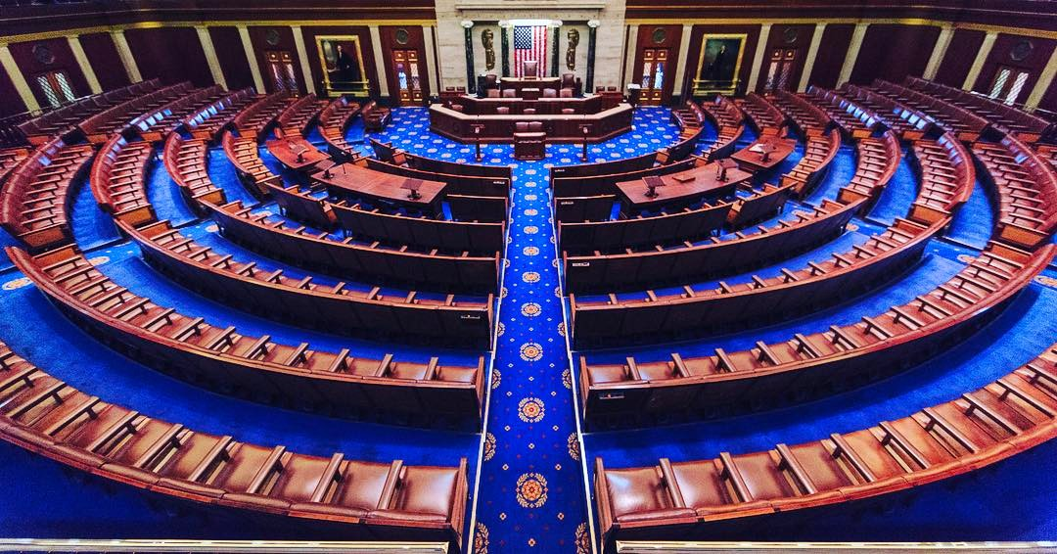
Women’s Numbers – Elected Office
Women in the US Senate EVER, since 1789: 58.
Today: 24; 24%.
Women in the US House EVER: 345.
Today: 118; 27%.
Women in state legislatures, total today: 31%.

Slide 12
CEDAW’s Core Principles
Substantive Equality
Non-Discrimination
State Obligation
Notes:
CEDAW has three interwoven core principles: substantive equality, non-discrimination, and state obligation.
3) The countries who have ratified CEDAW are state-parties to the treaty, meaning their government has signed on to the treaty and, by doing so, agreed to take measures to improve the status of women in the country.

Slide 13
What is CEDAW?
6 Parts, 30 Articles.
I – Overview: equality in political, social, economic, and cultural spheres.
2 – Equality in political and public spheres.
Right to vote; participate in government; acquire, change, or retain nationality.

Slide 14
3 – Equality in education, employment, health; special needs for rural women.
4 – Equality in civil matters – contracts, rights of residence, right to enter or dissolve marriage and to freely choose a spouse.

Slide 15
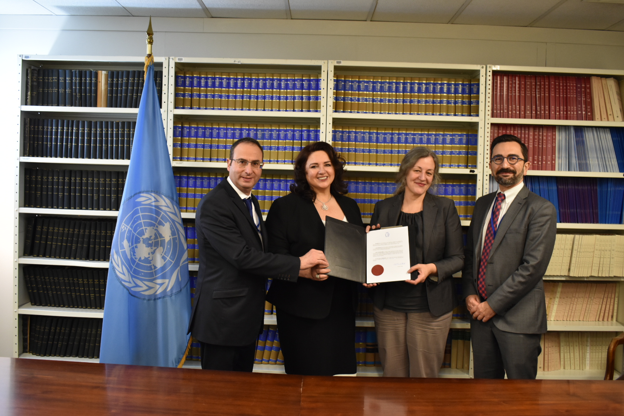
5 – UN review committee; 4-year reports.
6 – UN ratification process.

Slide 16
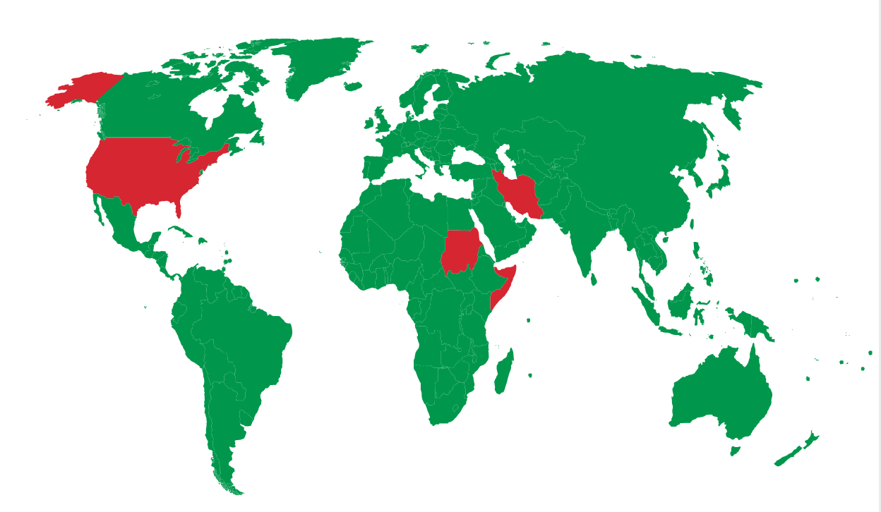
Nations that have NOT ratified CEDAW

Slide 17
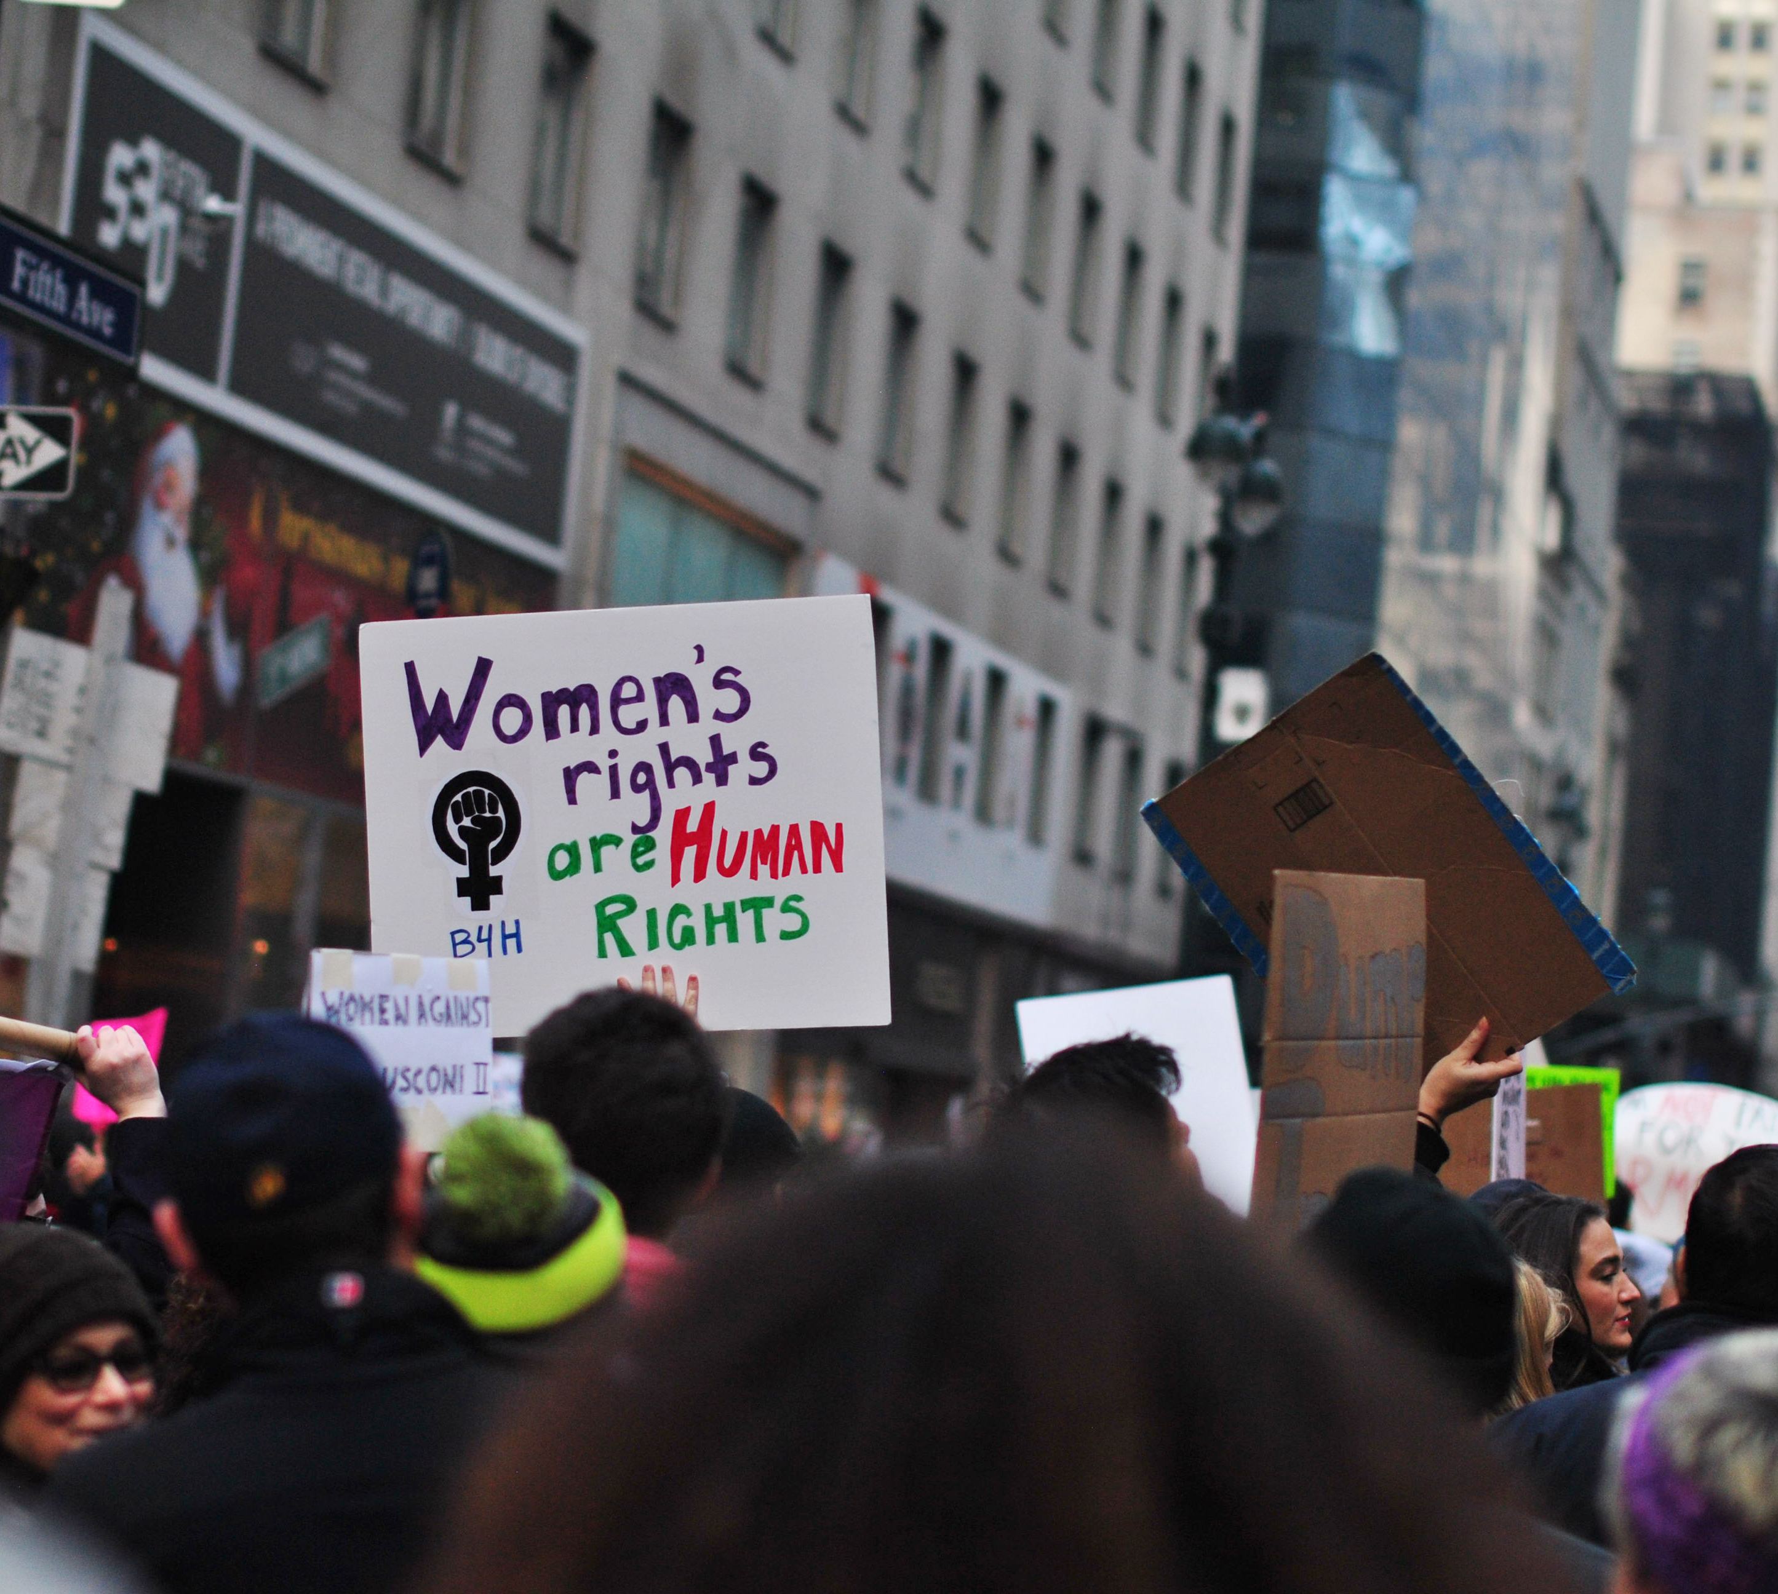
US Ratification of CEDAW

Slide 18
The Ratification Process
Senate Foreign Relations Committee

Slide 19
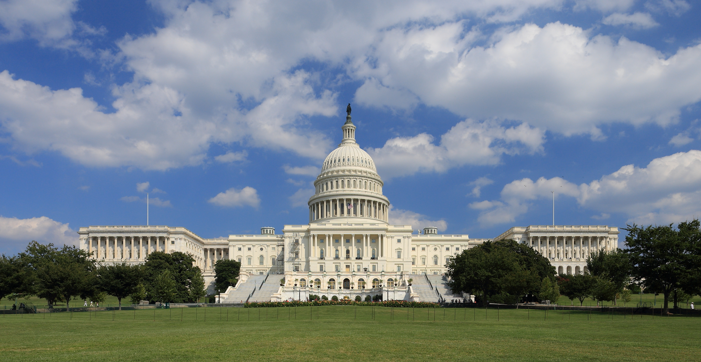
The Ratification Process
67 YES votes in the Senate

Slide 20
CEDAW's History in the US

Slide 21
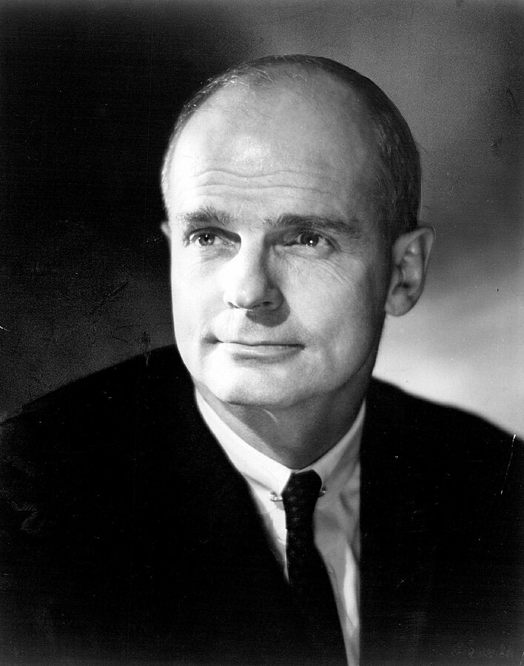
Obstacles to Ratification
US ‘exceptionalism’
No ‘Proxmire for CEDAW’
Misunderstandings

Slide 22
MYTH #1
Ratification would give the international community too much power over U.S. law.
FACT
Bills to implement CEDAW provisions would have to be passed in the House and Senate..

Slide 23
MYTH #2
Discrimination is too broadly defined in CEDAW.
Implementation would result in “frivolous” law suits.
FACT
The same strict standards would apply to sex discrimination claims that apply to race discrimination. CEDAW wouldn’t result in frivolous lawsuits any more than challenges to race discrimination.

Slide 24
MYTH #3
CEDAW will destroy traditional family structure by redefining roles of men and women.
FACT
CEDAW does not regulate family life.
CEDAW urges states ‘to adopt education and information programs to eliminate prejudices and practices that hinder women’s full social equality.’

Slide 25
MYTH #4
CEDAW encourages abortion by promoting access to ‘family planning.’
FACT
CEDAW does not address abortion.
Countries where abortion is illegal have ratified CEDAW –
Burkina Faso, Rwanda.
U.S. State Department:
CEDAW is ‘abortion-neutral.’

Slide 26
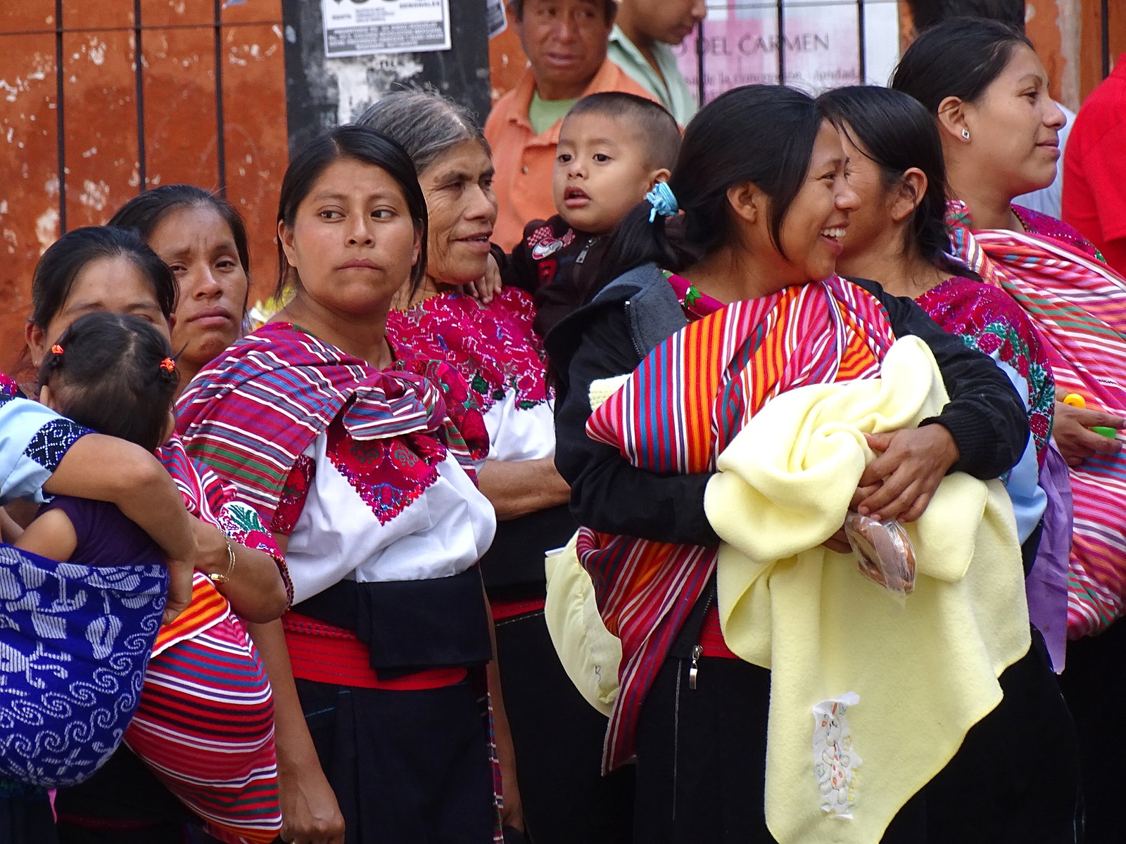
CEDAW’s Impact Around the World

Slide 27
Why the US should ratify CEDAW
Demonstrate global commitment to women’s rights.
Be part of the international community.
Address local discrimination and violence.

Slide 28
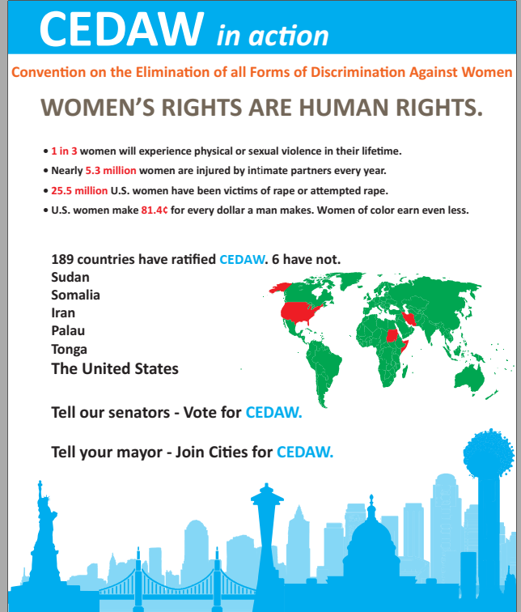

Slide 29
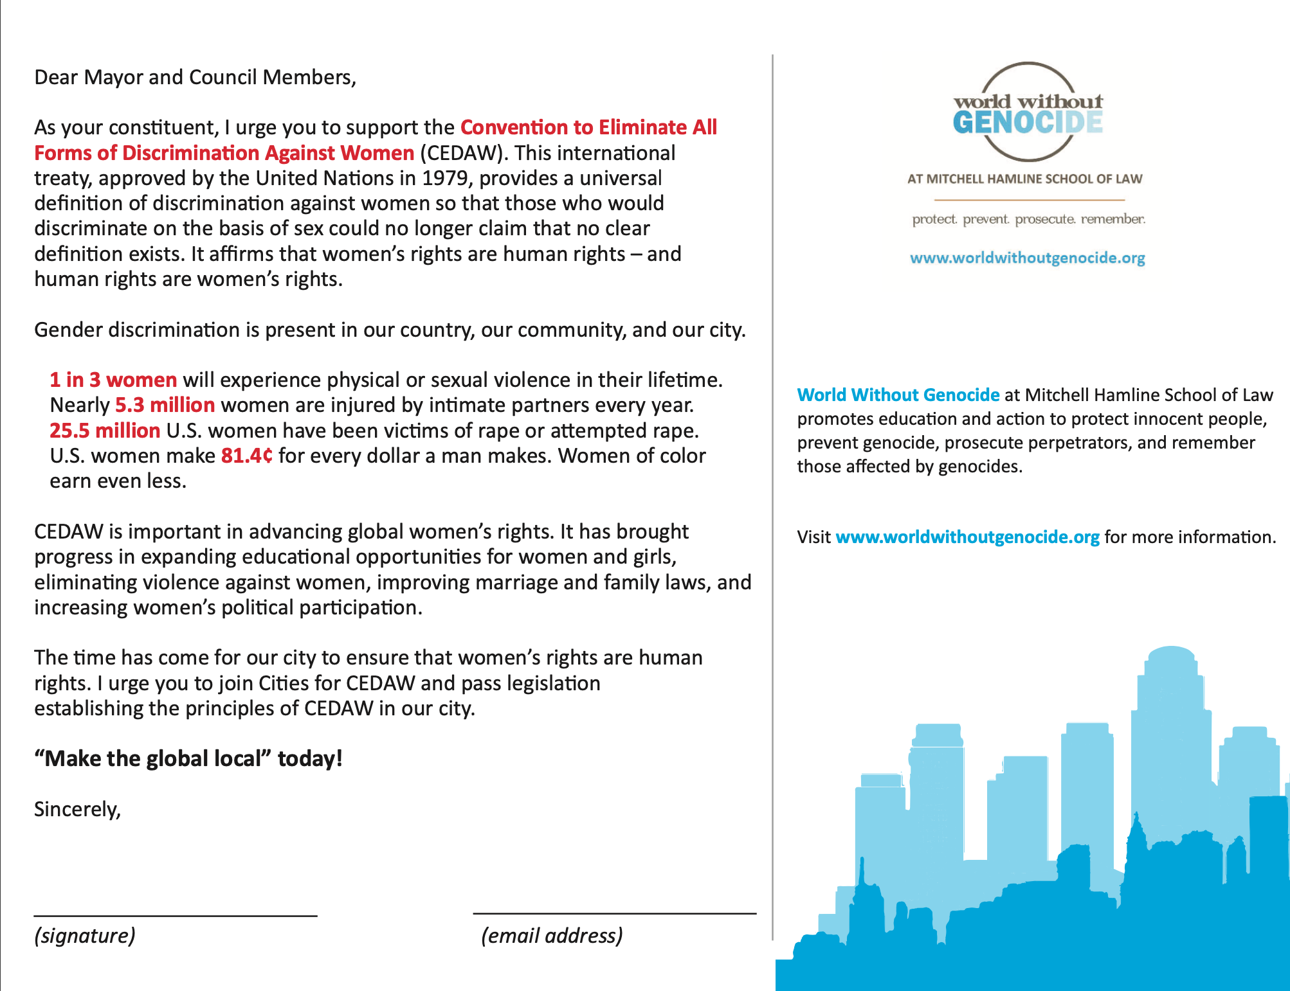
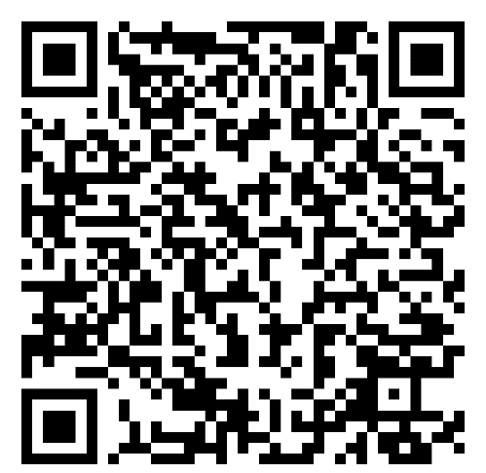

Slide 30
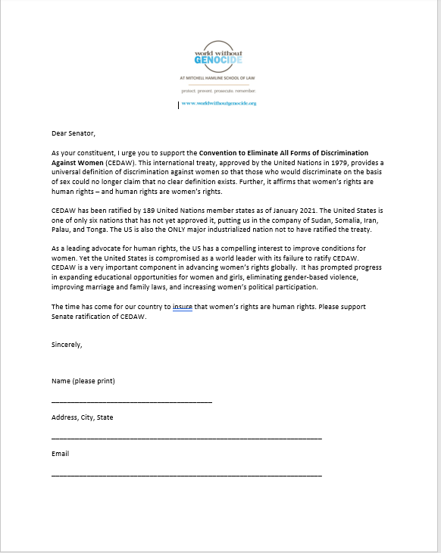
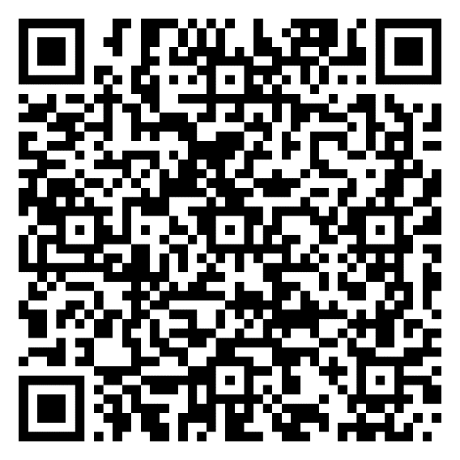

Slide 31
World Without Genocide Action for CEDAW
Minnesota support
Minneapolis, St. Paul, Duluth, Edina, Red Wing, Richfield
Minnesota State Bar Association – 17,500
Minnesota Nurses Association – 21,000
Nationally:
42 CITIES FOR CEDAW and more than 200 organizations
Education and advocacy to raise awareness, end discrimination, and stop violence against women and girls.

Slide 32
Action for CEDAW
Engage with mayors and city human rights commissions to support Cities for CEDAW.
Urge organization leaders to ratify CEDAW.
Sign letters to senators advocating for CEDAW.

Slide 33
kennedy@worldwithoutgenocide.org
www.worldwithoutgenocide.org

Slide 34
Image attributions and data sources
World Without Genocide logo, slide 2: © World Without Genocide 2023.
Gender pay gap, slide 5: image courtesy of Open Clip Art Library is unmodified and licensed under CC0 1.0.
USA flag map, slide 6: image courtesy of Lokal_Profil is unmodified and licensed under CC BY-SA 2.5.
National numbers references, slide 7: http://psychiatry.emory.edu/niaproject/resources/dv-facts.html ; https://data.worldbank.org/indicator/SH.STA.MMRT?locations=CA-US&year_high_desc=false .
National numbers references, slide 8: https://www.americanprogress.org/issues/women/reports/2020/08/03/488536/basic-facts-women-poverty/ ; https://www.cnbc.com/2020/09/18/new-census-data-reveals-no-progress-has-been-made-closing-the-gender-pay-gap.html ; https://www.worldvision.org/sponsorship-news-stories/global-poverty-facts#:~:text=In%20the%20United%20States%2C%2011.8,according%20to%20the%202018%20census .
National numbers references, slide 9: https://padv.org/ ; http://www.endthebacklog.org/ ; https://vpc.org/studies/amroul2020.pdf .
U.S. House of Representatives chamber, slide 10: image courtesy of Office of the Speaker of the House/United States House of Representatives is unmodified and is located in the public domain.
CEDAW logo, slide 11: image courtesy of CEDAW, UN is unmodified and licensed under CC BY-SA 3.0.
Lady Justice, slide 12: image courtesy of Pxhere is unmodified and licensed under CC0.
Vote icon, slide 13: image courtesy of ArtsyBeeKids is unmodified and licensed under Pixabay’s Content License.
Hand signing paperwork, slide 14: image courtesy of Pixnio is flipped horizontally and is licensed under CC0.
Ratification of the Optional Protocol to CEDAW, slide 15: image courtesy of EU editor 19 is unmodified and licensed under CC BY-SA 4.0.
Nations that have not ratified CEDAW, slide 16: image courtesy of IdiotSavant is modified and is located in the public domain.
Women’s rights are human rights, slide 17: image courtesy of Narih Lee is unmodified and licensed under CC BY 2.0.
Gavel, slide 18: image courtesy of Quince Media is unmodified and licensed under CC BY-SA 4.0.
U.S. Capitol, slide 19: image courtesy of Martin Falbisoner is unmodified and licensed under CC BY-SA 3.0.
CEDAW’s history in the US, slide 20.
U.S. flags, slide 21: image courtesy of pxhere is unmodified and licensed under CC0.
Senator William Proxmire, slide 21: image courtesy of United States Congress is unmodified and is located in the public domain.
Viqarunnisa Noon School and College, slide 26 (upper left): image courtesy of SazzadHossain is unmodified and licensed under CC BY-SA 4.0.
Woman in wheelchair, slide 26 (upper middle): image courtesy of Pablo Stanley is unmodified and licensed under CC BY 4.0.
People on the streets of Japan, slide 26 (right): image courtesy of Holly Ireland is unmodified and licensed under CC0.
Vote ballot box, slide 26 (lower left): image courtesy of Thor_Deichmann is unmodified and licensed under Pixabay’s Content License.
Indigenous women outside church in Mexico, slide 26 (lower middle): image courtesy of Adam Jones is unmodified and licensed under CC BY-SA 2.0.
CEDAW in action flier, slide 28: image courtesy of World Without Genocide is unmodified and licensed under CC0.
End Gender Discrimination postcard, slide 29: image courtesy of World Without Genocide is unmodified and licensed under CC0.

