Slide 1
THE LINE
a true story

Slide 2
1933-1945,
Germany

Slide 3
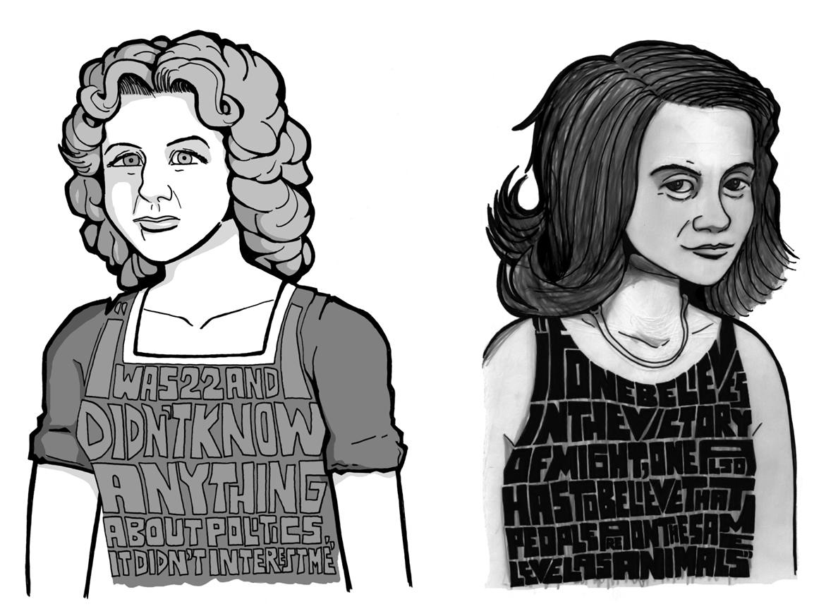

Slide 5
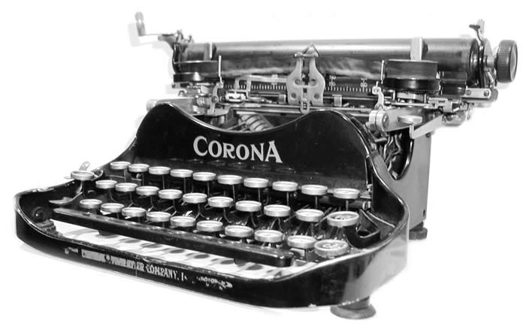

Slide 6
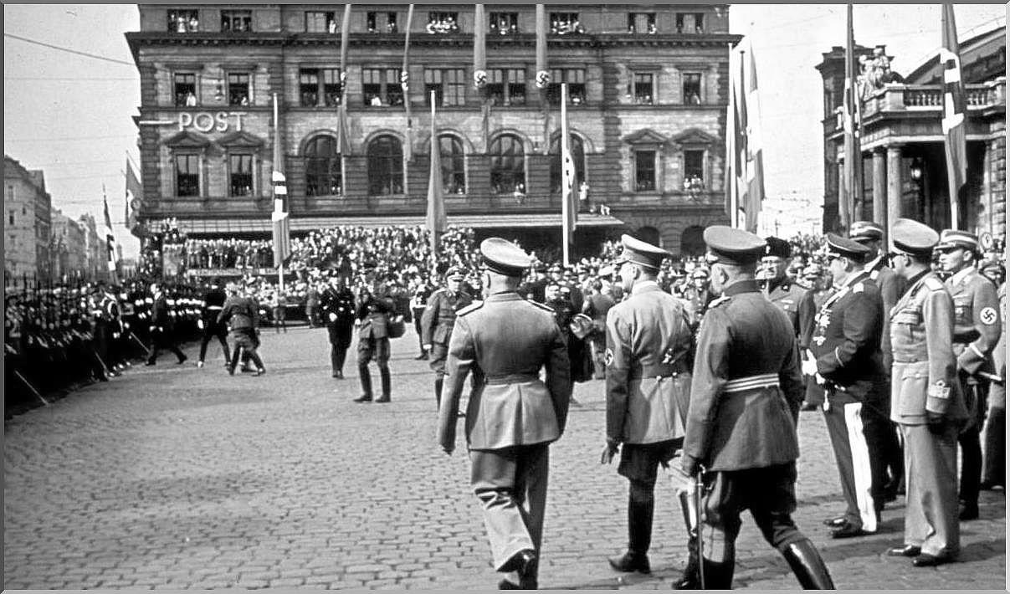

Slide 8
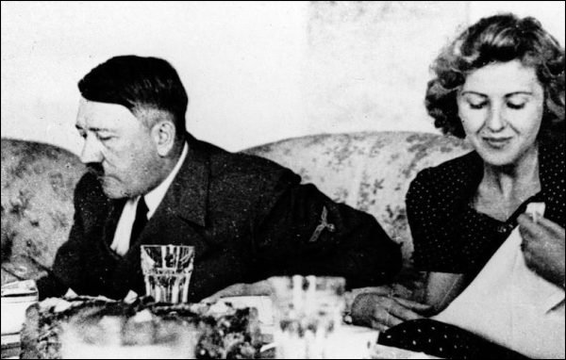

Slide 9
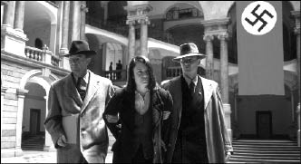
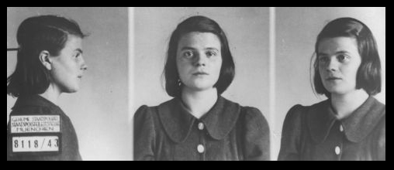

Slide 11
“All of a sudden, I had no excuse anymore.”

Slide 12
“It was no excuse to be young.”

Slide 13
Sophie Scholl
1921-1943

Slide 14
Traudl Junge
1920-2002

Slide 16
This is the story of a
L
I
N
E

Slide 17
A line that separates those who stand up
from those who merely obey orders.

Slide 18
That separates difficult
from easy.

Slide 19
That separates being true to
yourself
from conformity.

Slide 22
True Story.
World Without Genocide 2016

