Slide 1
CEDAW The Convention on the Elimination of Discrimination against Women
© World Without Genocide 2017

Slide 2
Women’s Rights From the Bench…
1855: Missouri v. Celia, a black woman is property without right to defend herself against a master’s act of rape.
1873: Bradwell v. Illinois, Supreme Court ruled that a state can exclude a married woman from practicing law.
1951: Hoyt v. Florida, Supreme Court upholds Florida rules making it less likely for women than men to be called for jury duty because “a woman is still regarded as the center of home and family life.”

Slide 3
Women’s Rights From the Bench…
1965: Griswold v. Connecticut, Supreme Court overturns one of the last state laws prohibiting use of contraceptives by married couples.
1971: Phillips v. Martin Marietta Corp., Supreme Court outlaws the practice of private employers refusing to hire women with pre-school children.
1974: Cleveland Board of Ed. v. LaFleur, Supreme Court determines it is illegal to force pregnant women to take maternity leave on the assumption they are incapable of working in their physical condition.

Slide 4
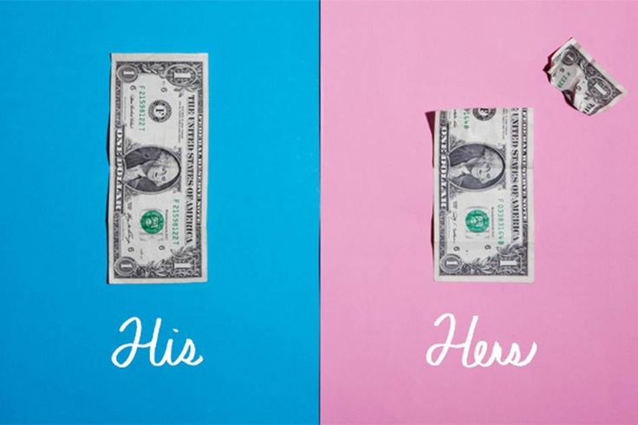
Women’s Rights From the Bench…
2015: Ewald v. Royal Norwegian Embassy – Minnesota District Court finds that Norway violated equal-pay law by paying a female employee $30,000 less than her male counterpart.

Slide 5
What are some challenges
facing women in the US today?

Slide 6
National Numbers
1 in 4 college women will be sexually assaulted.
2,400,000 women in the US report injuries from intimate partners.
US – ranks 61st out of 184 countries on maternal deaths during pregnancy and childbirth

Slide 7
National Numbers
Every nine seconds, a woman in the US is assaulted or beaten.
Women constitute 94% of the victims of murder-suicides in the US.

Slide 8
National Numbers
Women make 78 cents to a man’s dollar, a gender gap of more than 20%.
Women of color make less.
African-American 64 cents
American Indian 59 cents
Latina 54 cents
Of 37,000,000 Americans living in poverty, 56% are women.

Slide 9
Minnesota Numbers
684,000 Minnesota women will be raped, stalked, or experience violence by an intimate partner in their lifetimes.
MN District Courts: 27,288 domestic violence cases.
10,965 orders for protection.
Twin Cities on any weekend night:
45 girls under 18 sold for sex.

Slide 10
There are 3,470 untested rape kits in Minnesota, 400,000 in the US.
At least 115 Minnesota women were murdered
by their intimate partners, 2010-2015.
At least 300 women were sexually assaulted on Minnesota college campuses in 2015.

Slide 12
CEDAW’s Core Principles
Substantive Equality
Non-Discrimination
State Obligation
Notes:
CEDAW has three interwoven core principles: substantive equality, non-discrimination, and state obligation.
3) The countries who have ratified CEDAW are state-parties to the treaty, meaning their government has signed on to the treaty and, by doing so, agreed to take measures to improve the status of women in the country.

Slide 13
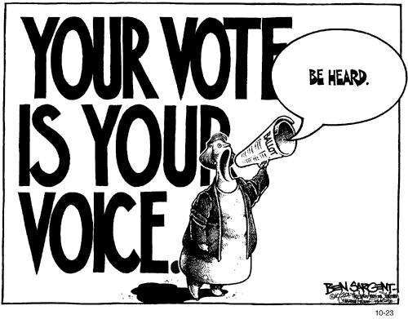
What is CEDAW?
6 Parts, 30 Articles.
I – Overview: equality in political, social, economic, and cultural spheres.
2 – Equality in political and public sphere.
Right to vote, participate in government, acquire, change, or retain nationality.

Slide 14
3 – Equality in education, employment, health; special needs for rural women.
4 – Equality in civil matters – contracts, rights of residence, right to enter or dissolve marriage and to freely choose a spouse.

Slide 15
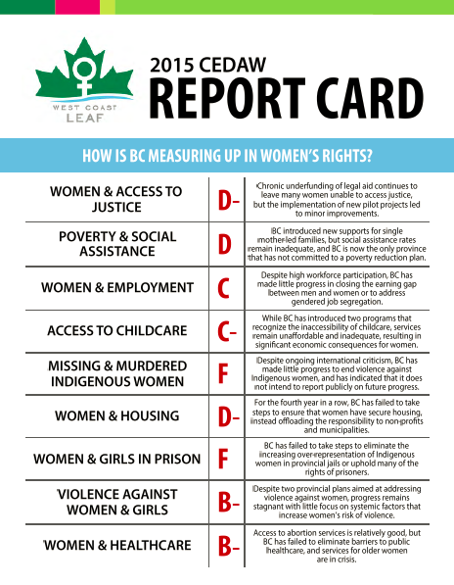
5 – Establishment of a UN review committee; regular 4-year reports.
6 – UN ratification process.

Slide 16
Nations that have NOT ratified CEDAW

Slide 17
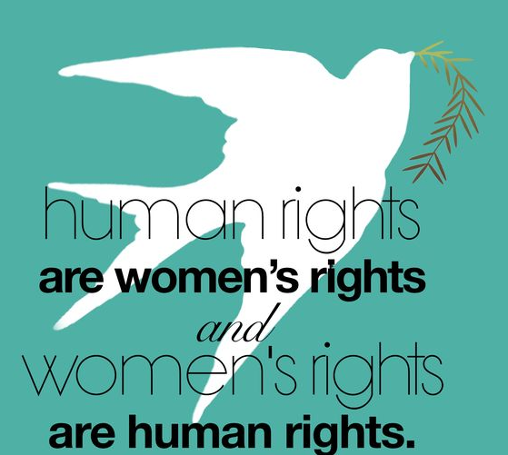
US Ratification of CEDAW

Slide 18
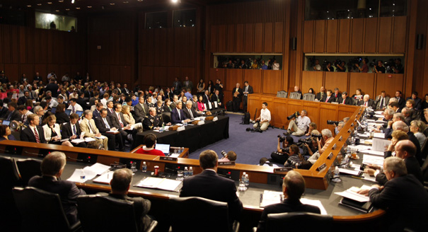
The Ratification Process
Senate Foreign Relations Committee

Slide 19
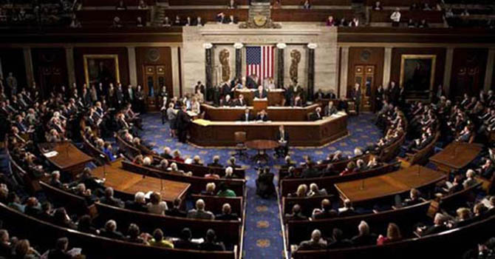
The Ratification Process
67 YES votes in the Senate

Slide 21
Obstacles to Ratification
US ‘exceptionalism’
No ‘Proxmire for CEDAW’
Misunderstandings

Slide 22
MYTH #1
Ratification would give the international community too much power over U.S. law.
FACT
Bills to implement CEDAW provisions would have to be passed in the House and Senate.

Slide 23
MYTH #2
Discrimination is too broadly defined in CEDAW. Implementation would result in “frivolous” law suits.
FACT
The same strict standards would apply to sex discrimination claims that apply to race discrimination. CEDAW wouldn’t result in frivolous lawsuits any more than challenges to race discrimination.

Slide 24
MYTH #3
CEDAW will destroy traditional family structure by redefining roles of men and women.
FACT
CEDAW does not regulate family life.
CEDAW urges states ‘to adopt education and information programs to eliminate prejudices and practices that hinder women’s full social equality.’

Slide 25
MYTH #4
CEDAW encourages abortion by promoting access to ‘family planning.’
FACT
CEDAW does not address abortion.
Countries where abortion is illegal have ratified CEDAW - Ireland, Burkina Faso, Rwanda.
U.S. State Department:
CEDAW is ‘abortion-neutral.’

Slide 26
Women’s Rights Globally
Notes:
That’s the case globally. Which, in the US, I think we have an easier time understanding: the rights of women on the other side of the world being trampled for “violations” that we would consider mundane in this country.

Slide 27
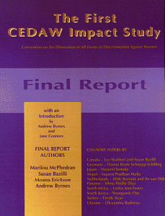
CEDAW’s Impact Around the World

Slide 28
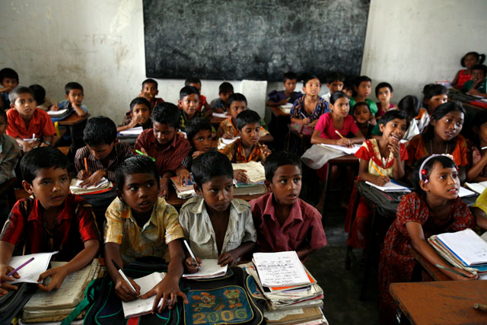
Schools, Bangladesh

Slide 29
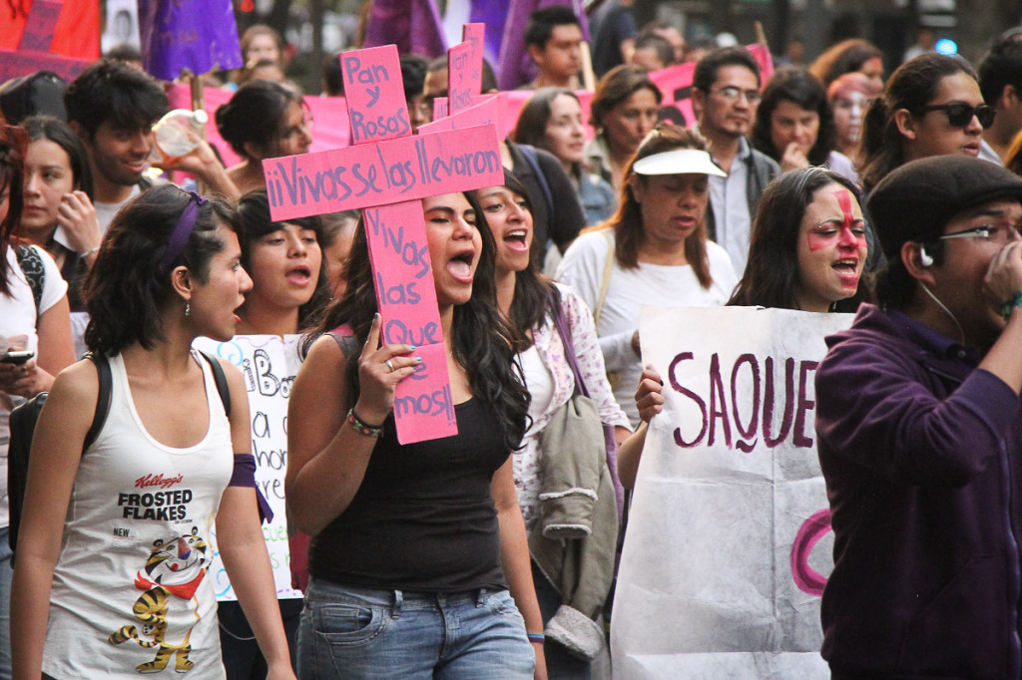
Ending Gender Violence, Mexico

Slide 30
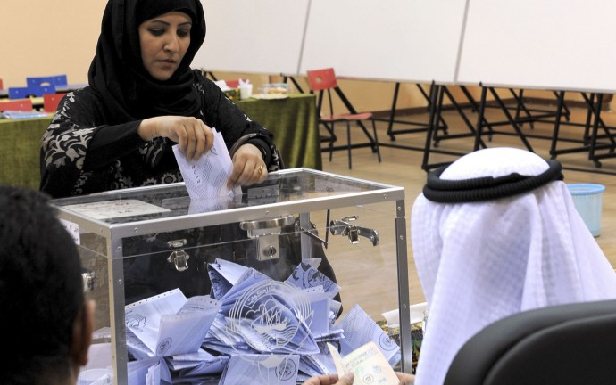
Voting, Kuwait

Slide 31
Agricultural rights, Honduras

Slide 32
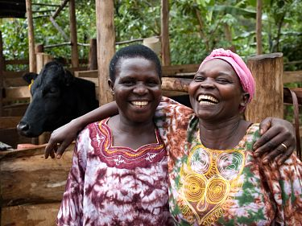
Domestic Violence Reduction, Uganda

Slide 33
Equal Employment Law, Japan

Slide 34
Reproductive Rights, Colombia

Slide 35
Why the US should ratify CEDAW
Demonstrate global commitment to women’s rights
Be part of the international community
Address local discrimination and violence

Slide 36
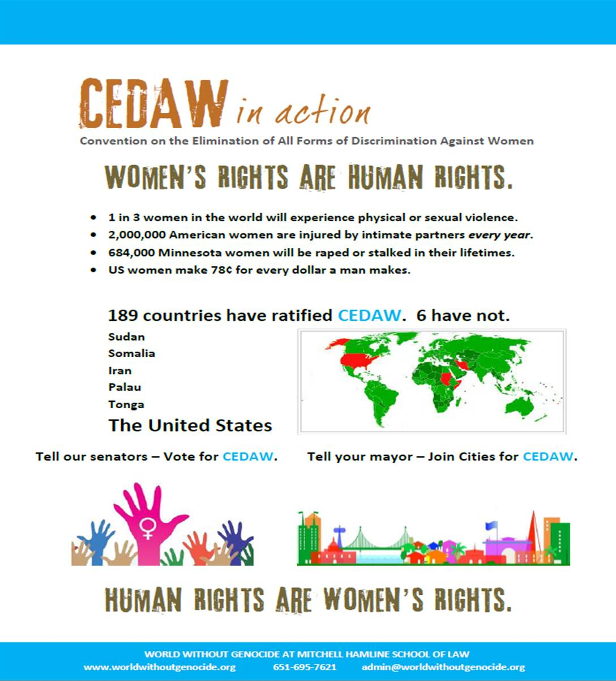

Slide 38
World Without Genocide Action for CEDAW
Minnesota ratification
Minneapolis, St. Paul, Edina
Minnesota State Bar Association – 17,500
Minnesota Nurses’ Association – 21,000
Education and advocacy to raise awreness and
end discrimination and violence against women.

Slide 39
Action for CEDAW
Sign letters to senators advocating for CEDAW.
Urge organization leaders to ratify CEDAW.
Engage with mayors and city human rights committees to join Cities for CEDAW.
Ask elected officials to advocate for CEDAW in Washington, DC.

Slide 40
Women’s Rights - Locally
-Minnesota Women’s Consortium
Notes:
But there is work to do here too. In the United States. In Minnesota. We’re not done yet.

